Slide 1
Leverett Open Space and Recreation Plan Update
Public Meeting
May 28, 2019
Notes:
Plan last updated in 2010. They expire every 7 years. Due for updated plan to continue to be eligible for state funding. State has very specific requirements as to what is included in an OSRP.

Slide 2
Plan Purpose
Provides comprehensive inventory of the Town’s natural & recreational resources.
Conducts an analysis of the open space & recreation needs.
Outlines real steps to achieve its goals.
Makes the Town eligible for state and federal grants for open space &recreation projects.

Slide 3
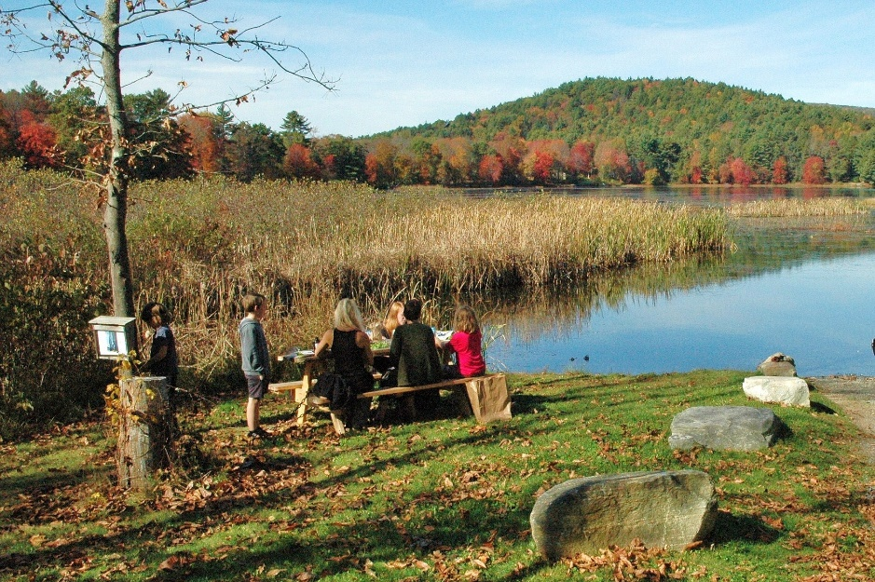
Update Process
Open Space Committee first met in May 2017.
Survey distributed in April 2019.
  86 responses received (4% of population).
There have been 11 public meetings during this update
  process.

Slide 4
Major Survey Results
Top recreational & open space resources in Town:
  Town Trails (Rattlesnake Gutter and others)
  Leverett Pond
  Roadsides (for walking & bicycling)
  New England Peace Pagoda
  Mt. Toby Trails

Slide 5
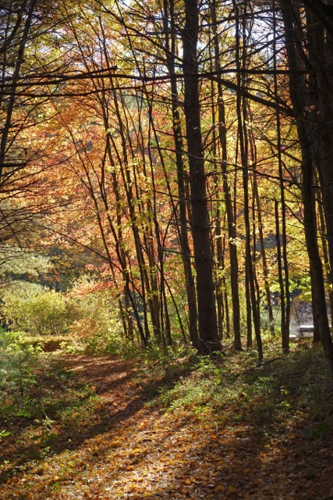
Major Survey Results
Top recreational activities in Town:
  Hiking
  Walking/Running
  Nature/Birdwatching
  Skiing/Showshoeing
  Boating/Kayaking

Slide 6
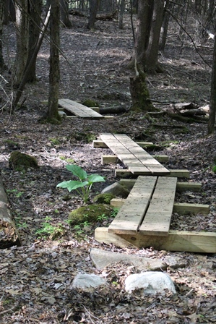
Major Survey Results
Most Respondents suggested that installing way-finding signs to the Town’s amenities would be helpful in improving awareness (82%).
Many respondents felt that existing resources are in good condition (79%).
Walking & bicycling are popular
activities – need for safer roads
was frequently mentioned.

Slide 7
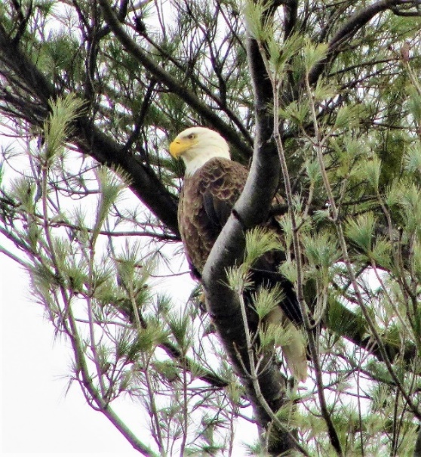
Major Survey Results
Top open space priorities for Town should be:
  Protect land for wildlife
  Protect land from development
  Protect drinking water resources
  Protect land along rivers and streams
  Encourage agriculture and protect farmland

Slide 8
Findings
Population continues to increase.
Seniors will compose 40% of population by 2035.
Much of the Town is protected from development and has strong natural resource zoning.
There are many unique natural and historic resources.
    Part of larger regional corridors of protected land
    Historic mill resources
Climate change is very important to residents.

Slide 9
Objectives & Action Plan
GOAL 1: Preserve Rural Character
Preserve historic and cultural resources including historic landscapes, homes, mills and cemeteries.
Explore various zoning options for managing growth.
Establish restrictions on roadside shade trees.

Slide 10
Objectives & Action Plan
GOAL 2: Protect and Preserve Natural Resources
Use GIS & field assessments to identify priority protection areas.
Pursue ways to protect & enhance priority protection areas.
  Protect land in Stoddard Hill area.
  Explore tax title process
  Place Conservation Restrictions on RGT & Town-owned lands for permanent protection.
  Set aside protected lands for wildlife & limit active recreation.

Slide 11
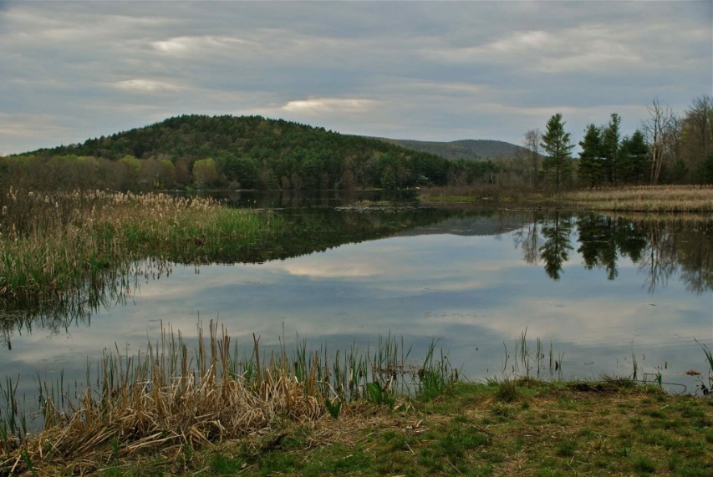
Objectives & Action Plan
Assess critical water resources.
  Mitigate salt use on roads
  Assess vulnerabilities of groundwater drinking sources.
Assess ways to increase resiliency due to climate change.

Slide 12
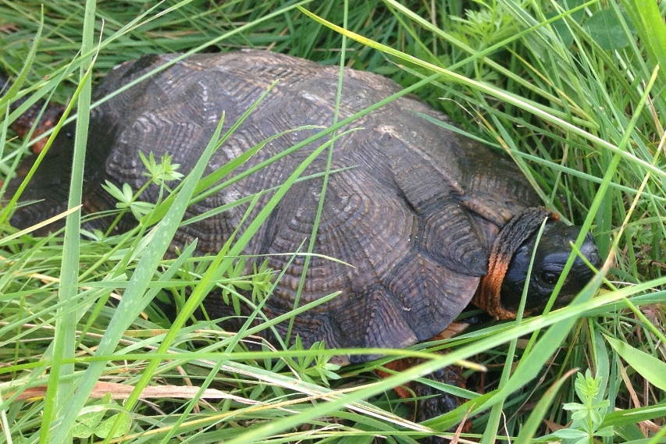
Objectives & Action Plan
GOAL 3: Improve & Maintain Public Education Related to Open Space.
Develop trail maps, guides, signage.
Maintain public info space on library and post info on website.
Continue to organize trail hikes in Town.

Slide 13
Objectives & Action Plan
GOAL 4: Promote Wide Recreational Usage of Natural Resources
Increase use of Leverett Pond
  Nuisance Aquatic Plant Management Plan
  Kayaks for public use
Expand trails around Town.
Improve access to open space for all residents.
  Accessible trail possibly at Elementary School with nature-based fitness options.
Implement Complete Streets on roadways.

Slide 14
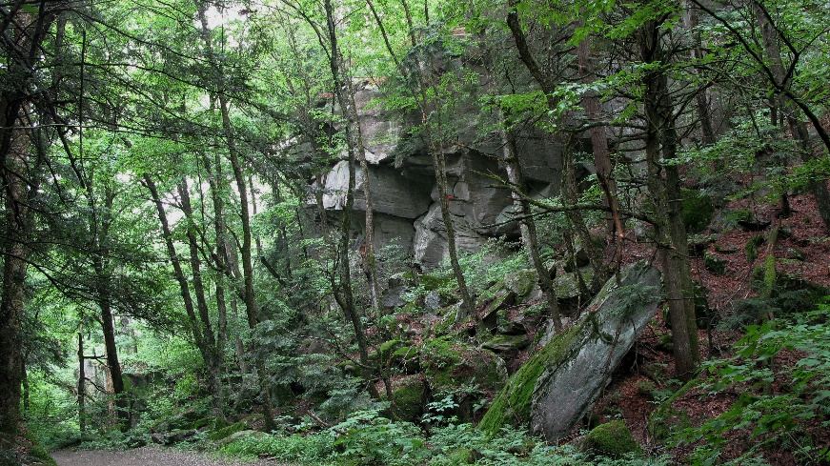
Next Steps
Public comment
  Obtain required letters of review from:
    Select Board & Planning Board
  If possible, obtain letters of review from :
    Conservation Commission
    Recreation Committee
    Board of Health
  Incorporate feedback received.
Submit Draft Plan to State
for approval.

Slide 15
Comments?
Comments due by Friday, June 14th.
Send to Megan Rhodes at mrhodes@frcog.org or call (413) 774-3167 x132.

