Slide 1
Leverett Fire Department Budget FY26
2/25/2025

Slide 2
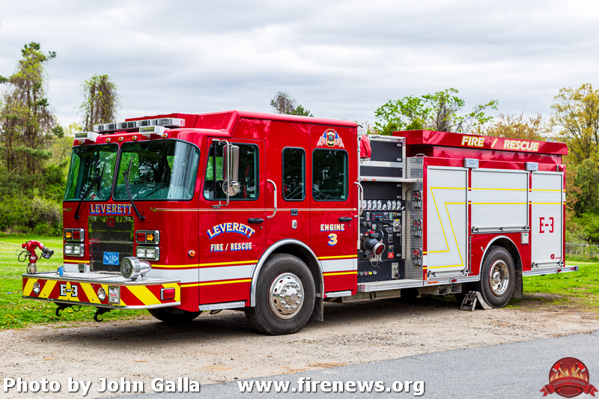
VEHICLE MAINTENANCE
MAINTENACE COST EXAMPLE
FY24 REPAIRS - $14,351.21
FY25 REPAIRS
Replacement Engine Cost:
$750,000.00-1,000,000.00
OIL CHANGE: ~$1,400.00 PER ENGINE PER YEAR
Must be performed by Emergency Vehicle Technicians (EVTs) due to their specialized onboard systems, strict NFPA compliance, and insurance requirements.
Other department oil changes and most vehicle maintenance/repairs are performed by Leverett Highway
Intake Valve Refurbishment: $625.50
Rebuild Tank to Pump Valve: $475.00
Air Compressor Replacement: $380.00
Rebuilt 3 discharge valves: $760.00
Engine 3 Wouldn't start - replaced cables and batteries Exhaust - rusted section removed and replaced Rebuilt leaking front connection hose valves Found issue with air compressor Fixed exhaust light on - manual regen to clean filter: $1,425
2 rebuild kit parts: $1,040.04
Air compressor part: $783.18
Both engines need oil changes before end of fiscal year.
Large invoice from DLC Repair in the next couple of weeks: performed several services recently on both engines and has not invoiced us yet for them.
Engine 2 – Repairs: $285.00
Engine 3 – Replacement Hose: $620.00

Slide 3
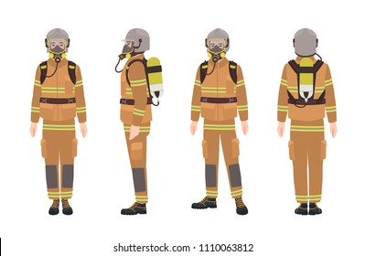
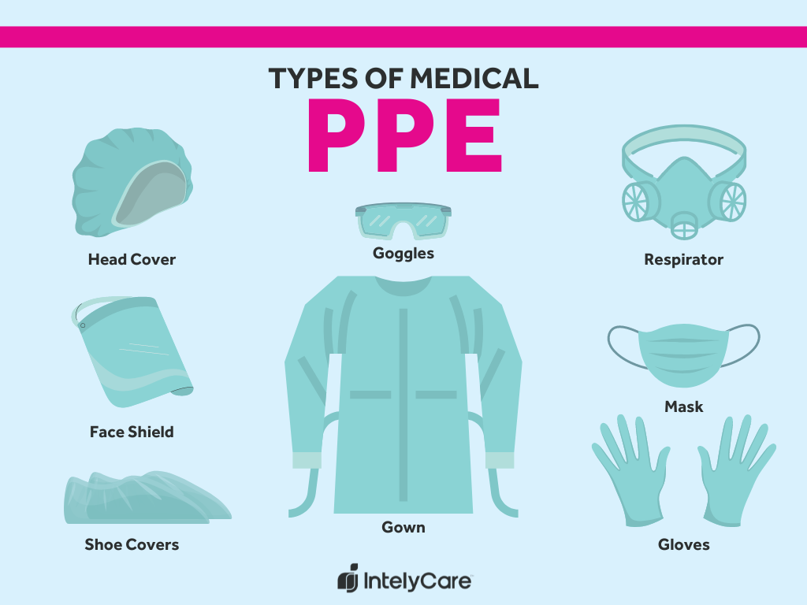
BUILT IN COSTS
PPE: up by $277/set in past month
Each set expires after 10 years but doesn’t always last this long and must fit individual fire fighters
Necessity of Uniform Response Clothing:
Professionalism
Trust
Protection from pathogenic fluids

Slide 4
BUDGET REDUCTIONS AND PENDING GRANTS FOR FY26
BUDGET REDUCTIONS
PAGER RENTAL: - $1,350 (100%)
PUMP TESTING: -$150 (15%)
GRANTS
AWARDED:
DFS FIREFIGHTER SAFETY EQUIPMENT: $10,500
PENDING AWARD:
DFS SAFE GRANT (REGIONAL): $7,200
DFS SENIOR SAFE GRANT (REGIONAL): $3,600
DCR VOLUNTEER CAPACITY GRANT: $3,500
TOTAL: $24,800

Slide 5
MAIN COST-INCREASE DRIVERS
Gear: inflation, materials, supply chain issues, and strict safety standards
Training
Vehicle Maintenance: rising costs of specialized parts, labor shortages, chip shortages, supply chain issues, and strict safety standards
EMS Supplies: increased call volume, supply chain shortages, regulatory changes, and inflation

Slide 6
With 2.5% Budget Increase: $1,288.00
No additional funding for vehicle maintenance, almost guaranteed to go over budget
No increase in EMS supplies, almost guaranteed to go over budget
No additional funding for training courses and materials, fewer training opportunities available for members
Requires reducing the uniforms budget by $400, not enough uniforms for members or members have to pay for their own (unlike other town departments)
No additional funding of clothing allowance for members, members required to pay more for their EMS PPE (unlike other town departments)
Since last budget hearing on 1/28/2025:
PPE prices have increased $554 ($277/set)
Fit Tester servicing has increased by $199/year by vendor

Slide 7
With 8.8% Budget Increase: $4,588.00
Only $400 additional funding for vehicle maintenance, strong likelihood of going over budget
Only $500 additional funding for training courses and materials, fewer training opportunities available for members
Since last budget hearing on 1/28/2025:
PPE prices have increased $554 ($277/set)
Fit Tester servicing has increased by $199/year by vendor

Slide 8
With 16.5% Budget Increase: $8,525.00
Since last budget hearing on 1/28/2025:
PPE prices have increased $554 ($277/set)
Fit Tester servicing has increased by $199/year by vendor
All other known needs are met

Slide 9
Final Notes
- The Leverett Fire Department has morphed into Leverett Fire/EMS and has been chronically underfunded as it modernizes.
- In the past 2 years, there has been an overall call volume increase of 23.6%
- 60% of those calls are Medical
- Uniform and Clothing allowances are less than those for the other Safety Complex Departments by $1,500 to $2,240
- The Chief faces the same issues of many departments: understaffing, rising costs, and increasing administrative work for the Chief.
- Grant funding and cheaper prices are constantly sought.

